Slide 1




Douglas’ Friends
A social media data analysis
By: Xuefei Qiao
Yaodan Cui
Khoa Nguyen
Mason Liu
Notes:
https://www.freepik.com/free-vector/people-doing-different-actions_3521084.htm
https://www.freepik.com/free-vector/hand-drawn-people-doing-outdoor-activities_2620727.htm

Slide 2
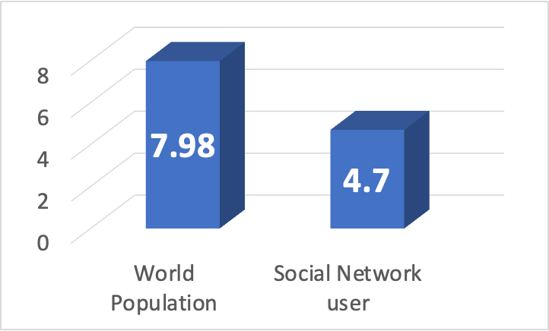
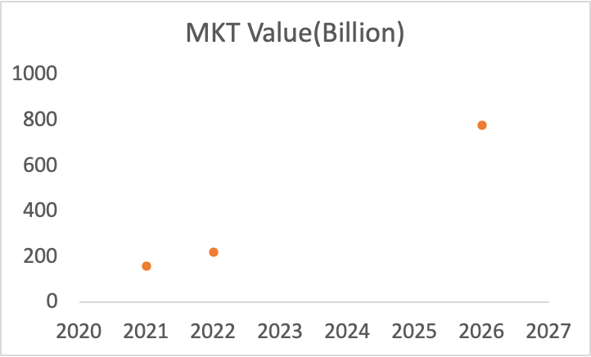
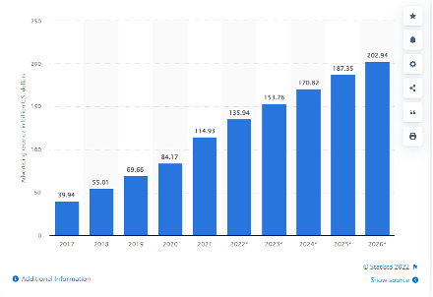
Why this analysis matters
Billion
CAGR: 37%
Population
MKT Value
Facebook AD

Slide 3



AGENDA
01
DATA SET
02
DESCRIPTIVE ANALYSIS
03
PREDICTIVE ANALYSIS
04
PROBLEMS APPLIED
05
CONCLUSIONS AND FUTURE WORK

Slide 4
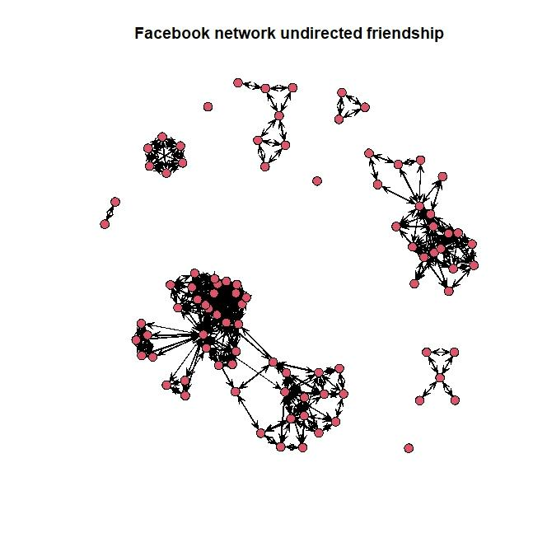
DATA SET
Network attributes:
vertices = 93
directed = FALSE
hyper = FALSE
loops = FALSE
multiple = FALSE
bipartite = FALSE
total edges = 323
Source: https://github.com/DougLuke/UserNetR
Vertex attributes:
friend_count
group
nutual_friend_count
relationship_status
sex
Missing value imputation:
Method: KNN
I graph to Edge list，Vertex attribute

Slide 5
DESCRIPTIVE ANALYSIS
5 Summary Numbers
Size | 93
Density | 0.076
Components | 10
Diameter | 3
Clustering Coefficient | 0.666

Slide 6
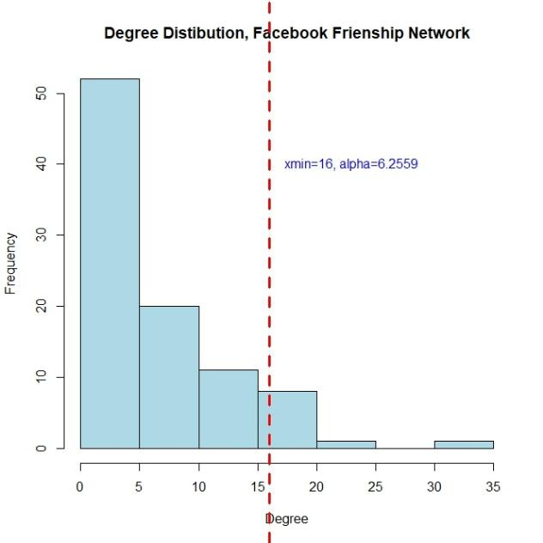
DESCRIPTIVE ANALYSIS
Degree
Distribution
Notes:
mean: 6.95

Slide 7
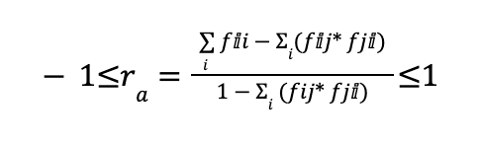
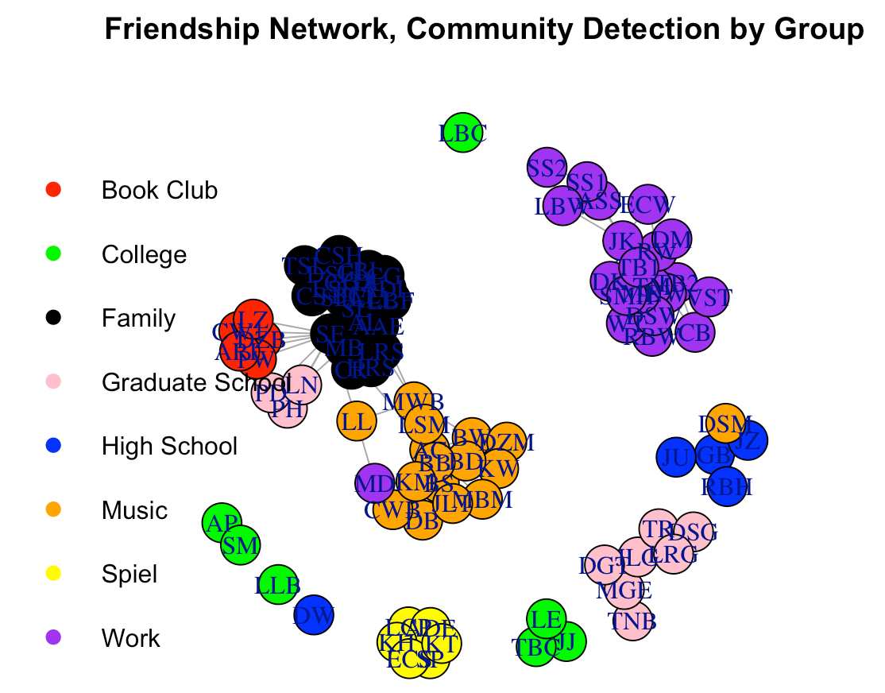
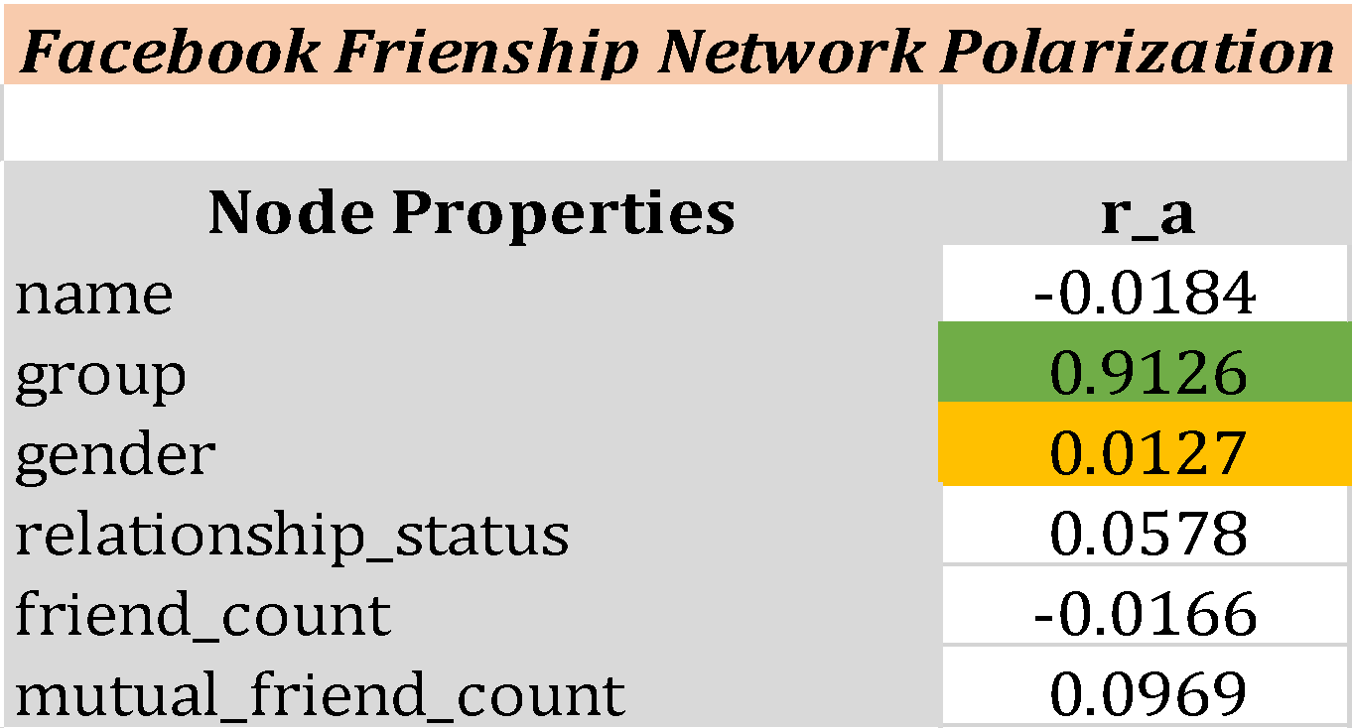
DESCRIPTIVE ANALYSIS
Polarization Assortativity

Slide 8
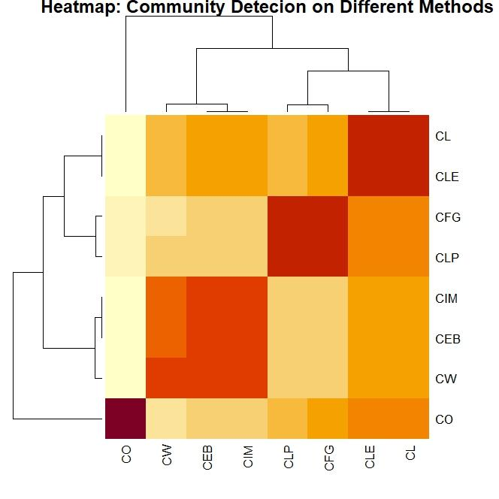
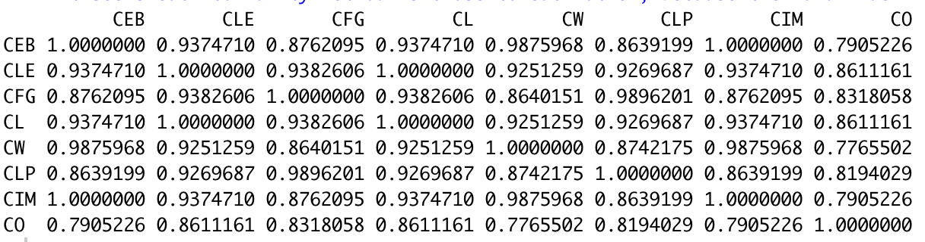
DESCRIPTIVE ANALYSIS
Community Detection

Slide 9
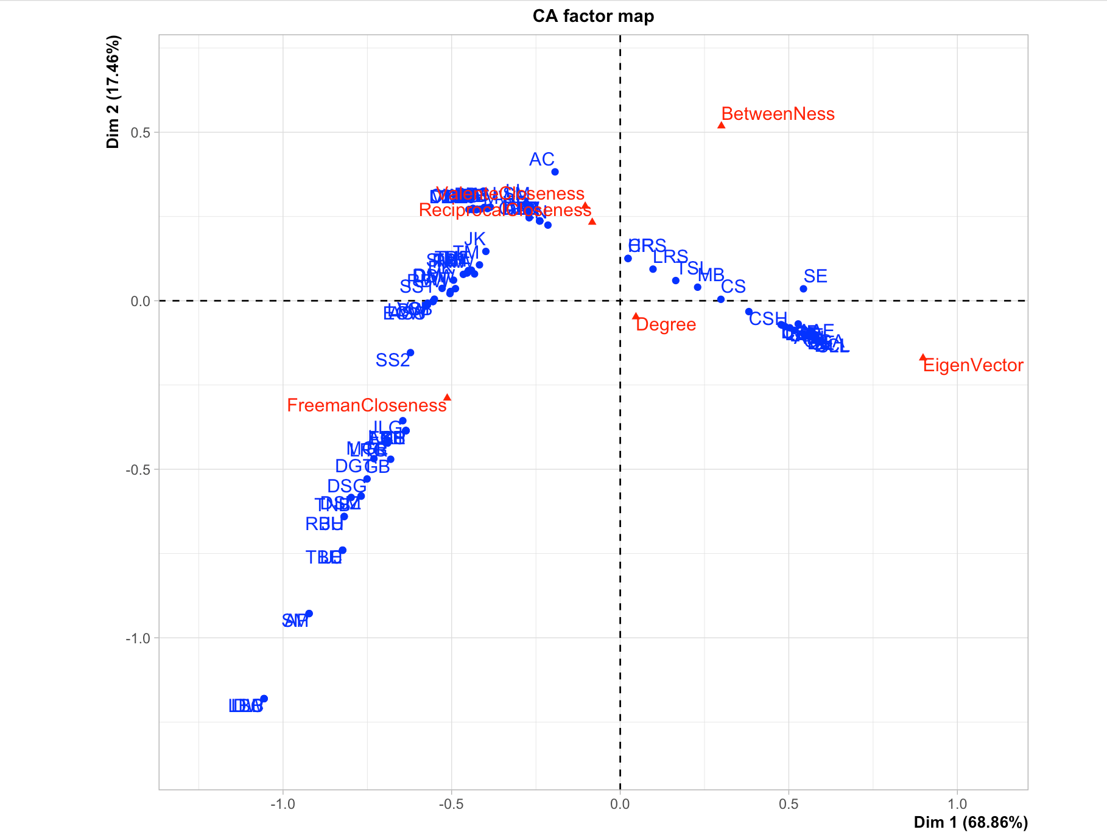
DESCRIPTIVE ANALYSIS
Centrality
Centrality Type | Name
Degree Centrality | SE (32 immediate friends)
Closeness Centrality | SE (Nearest, on average, to the rest of the crowd)
MCA | SE (Important in Dim 1)

Slide 10
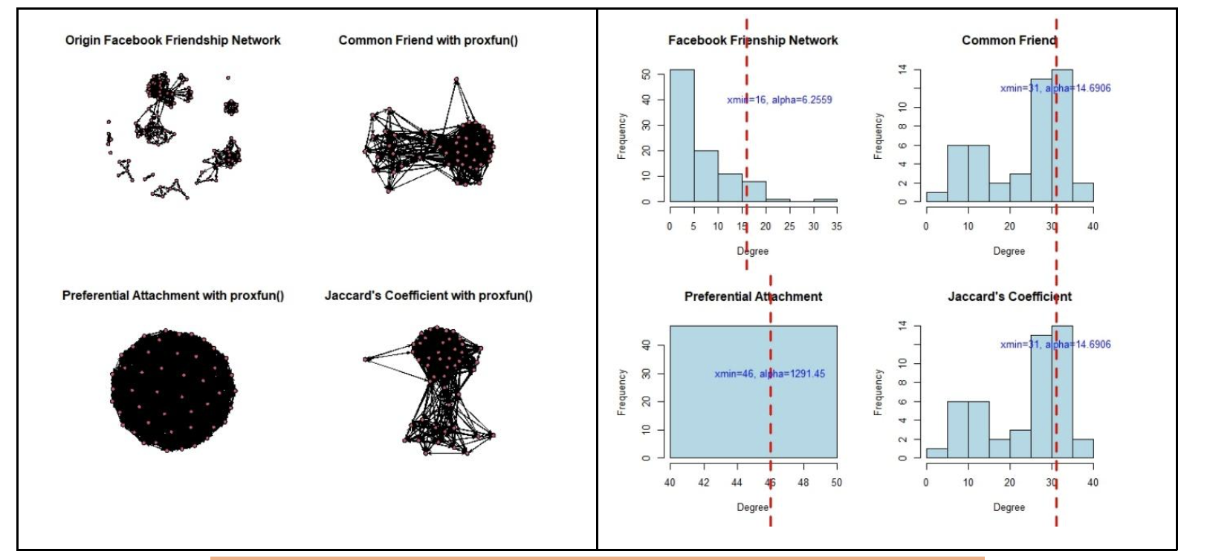
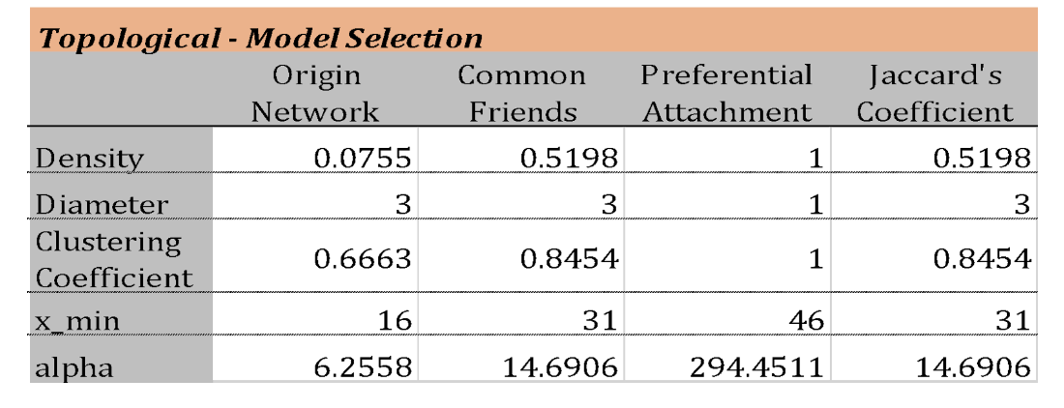
PREDICTIVE ANALYSIS
Link Prediction
The Component with Strongest Connection: 47 Nodes, 227 Edges

Slide 11
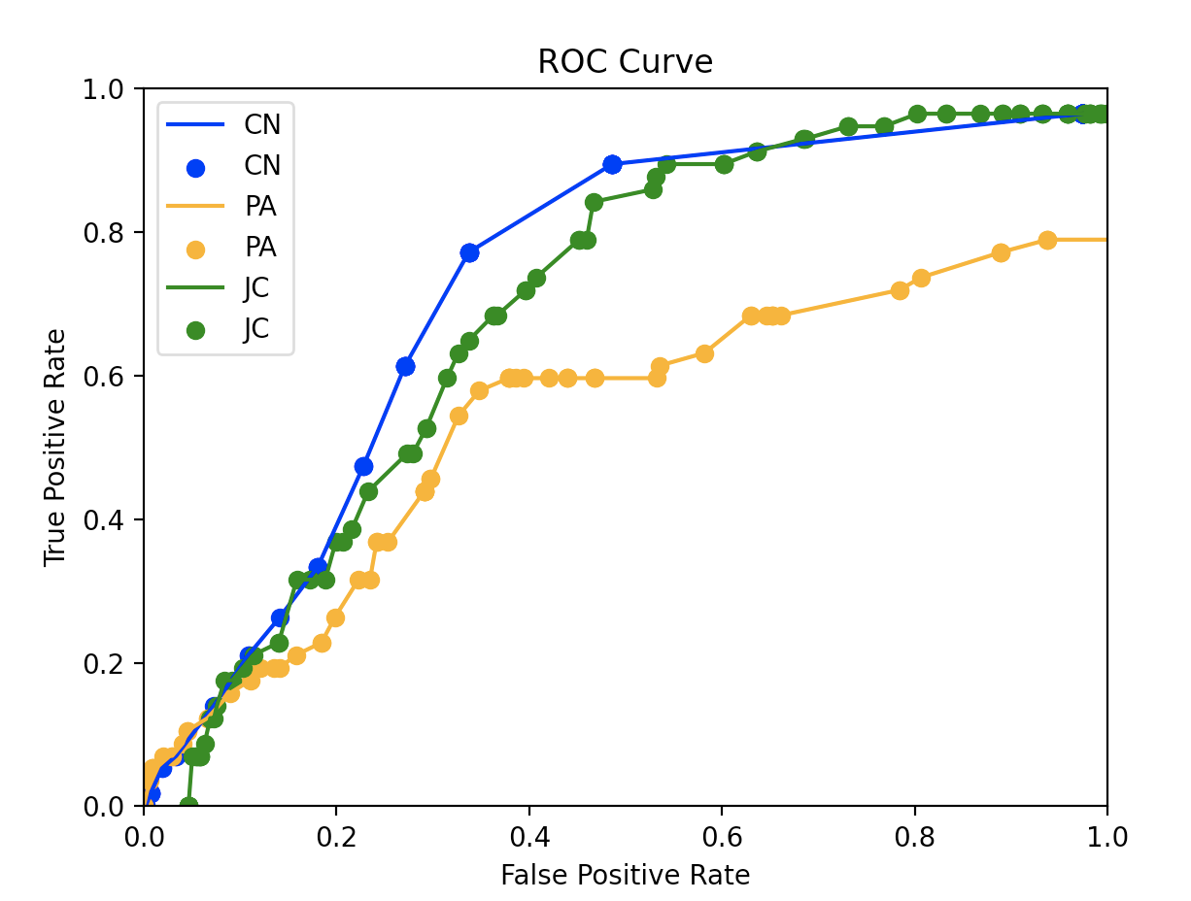
PREDICTIVE ANALYSIS
Link Prediction Cont
 | Training Graph | Test Graph
Number of Edges | 170 | 57
Number of Nodes | 47 | 47
P |  | 57
N |  | 1014

Slide 12
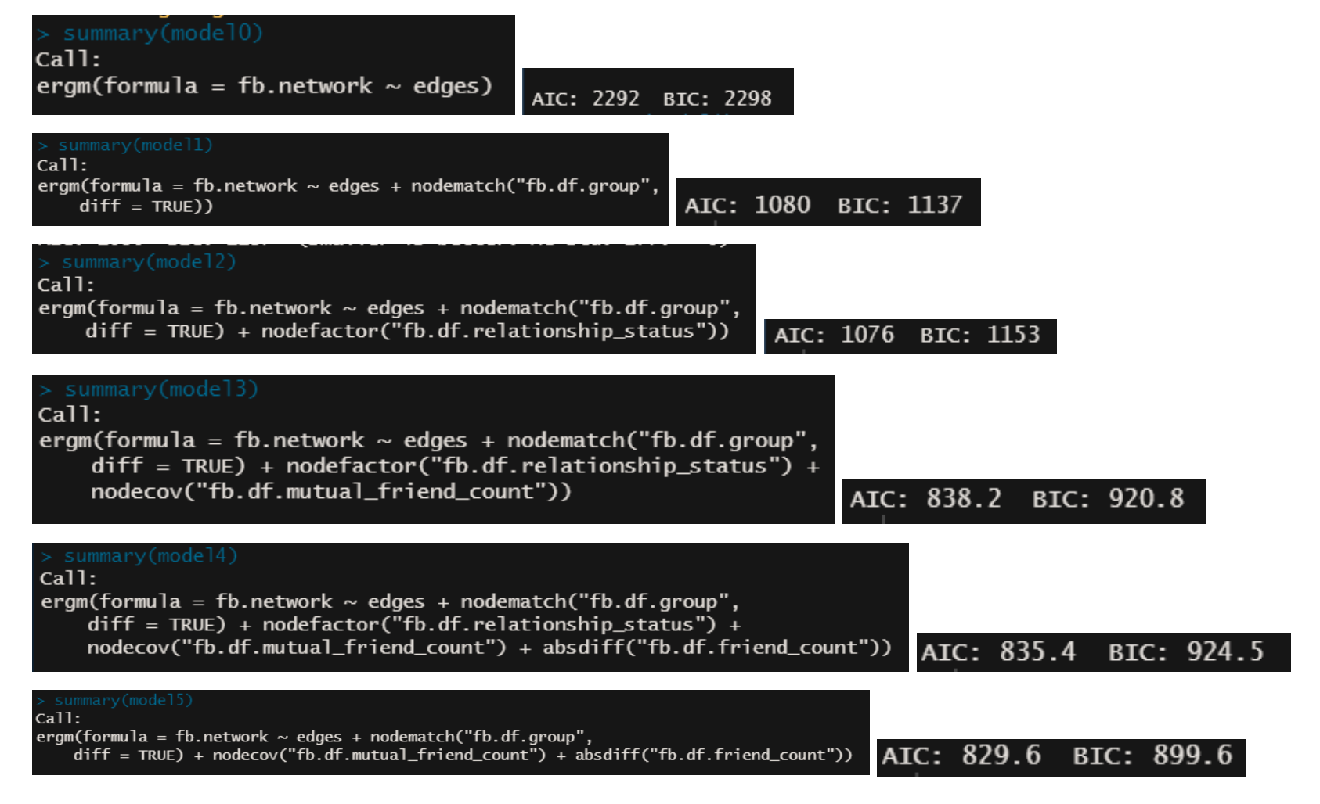
PREDICTIVE ANALYSIS
ERGM Models

Slide 13
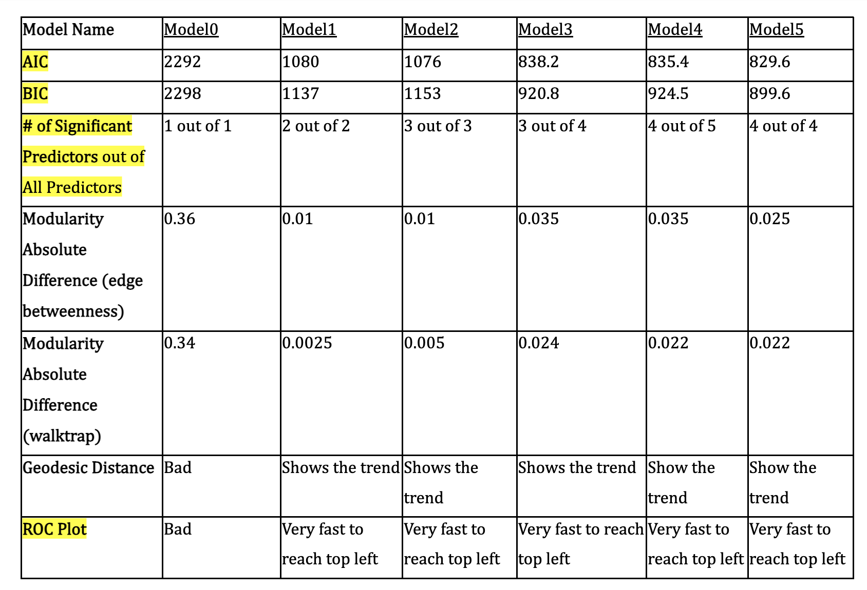
PREDICTIVE ANALYSIS
ERGM Diagnosis

Slide 14
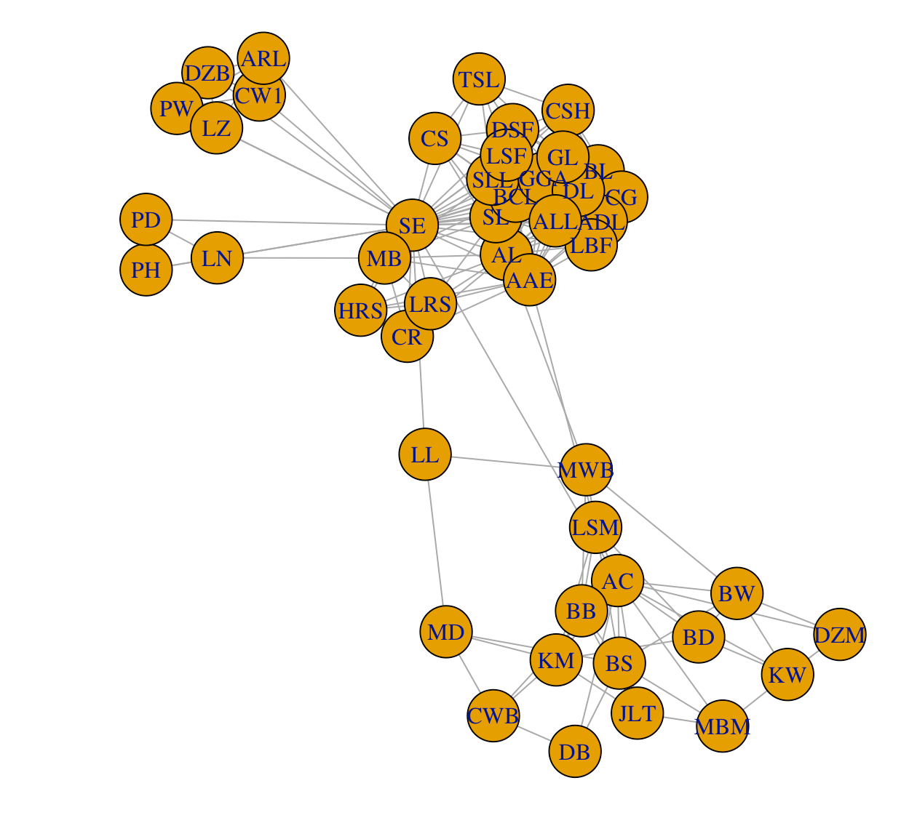
PROBLEMS APPLIED
the probability to find a person with 30 neighbors: 5.67e-10
In the strongest connected component, If the user KW wants to reach to the person who has the highest degree, how many steps this can be done in the fattest way?
2 steps in 1 way

Slide 15
PROBLEMS APPLIED
3) Without knowing any detail information, what’s the probability for a person to form friendship with another? 7.55%
4) Probability for 2 people becoming friend given some properties. If one user is in College club and has about 26 mutual friends with the author, a second user is in Music Club and has 6 mutual friends with the author, and they have absolute difference on friend count as 200, what’s the probability for them to become friends on FB? 99.99%

Slide 16



CONCLUSION
Among three topological methods, CN performs best.
Model 5 in ERGM analysis performed better than other 4 models based on the lowest AIC & BIC value and ERGM diagnosis.
People from same “Group” are more possible to become “Friend.”
The most “popular” person is SE who has 32 edges.
The degree of distribution is inequality.

Slide 17
FUTURE WORK
Expand a lager data set.
Involving multilayer analysis.
More analysis on social influence and network influence to affect specific type of people and how do they change over time.

Slide 18
Thank You!

